Slide 1
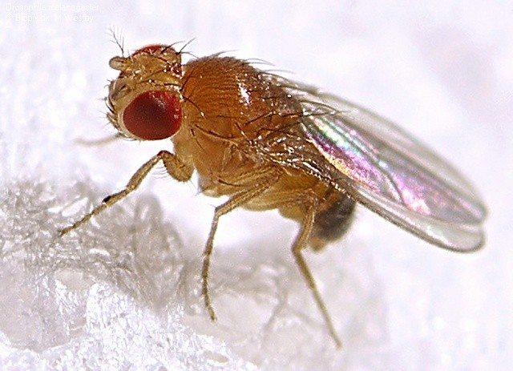
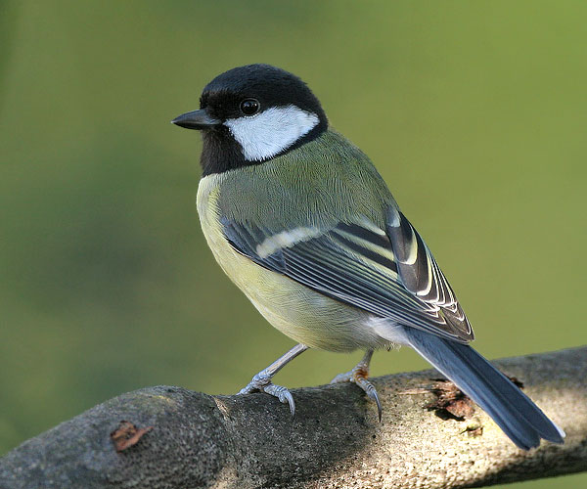


On The Hidden Nature of Complex Systems Macro Trends, Architecture, Nets, Grids, Bugs, Brains, and the Meaning of Life
David Meyer
CTO and Chief Scientist, Brocade
Director, Advanced Technology Center, University of Oregon
dmm@{brocade.com,uoregon.edu,1-4-5.net,…}
http://www.1-4-5.net/~dmm/talks/hidden.pptx

Slide 2
Agenda
Too many words, too many slides ☺
This talk is about thinking about networking in new ways
Goals for this Talk
A Few Macro Trends
What is Complexity and Why is it Hidden
Robustness, Fragility, and Complexity
The Architecture of Complex Systems
Universal Architectural Principles
A Few Conclusions and Q&A if we have time

Slide 3
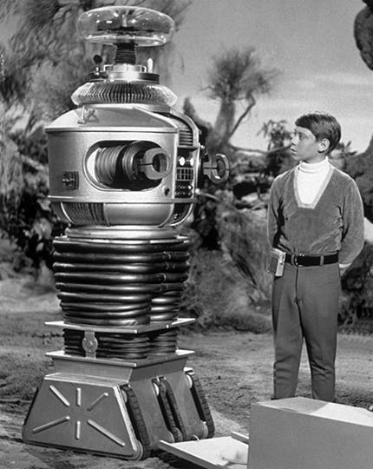
Danger Will Robinson!!!
Standard Disclaimer
This talk might be controversial/provocative
(and perhaps a bit “sciencey”)

Slide 4
Goals for this Talk
To open up our thinking about what the essential architectural features of our network are, how these features combine to provide robustness (and its dual, fragility), and how the universal architectural features that we find in both technological and biological networks effect Internet robustness, scalability and evolvability.

Slide 5
Agenda
Too many words, too many slides ☺
This talk is about thinking about networking in new ways
Goals for this Talk
A Few Macro Trends
What is Complexity and Why is it Hidden
Robustness, Fragility, and Complexity
The Architecture of Complex Systems
Universal Architectural Principles
A Few Conclusions and Q&A if we have time

Slide 6

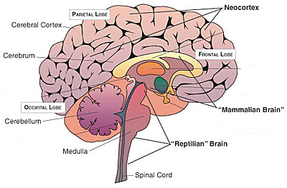
Trend: The Evolution of Intelligence
R-complex (Reptilian Brain) to Neocortex → Hardware to Software
HARDWARE
SOFTWARE
Ok, we’ve seen this slide
Key Architectural Features of Scalable/Evolvable Systems
RYF-Complexity (behavior)
Layered Architecture/Bowties and Hourglasses
Horizontal Transfer (H*T)
Protocol Based Architectures
Once you have HW
its all about code…
Sort of…consider
Embodiment/Virtualization
(neuroscience)

Slide 7


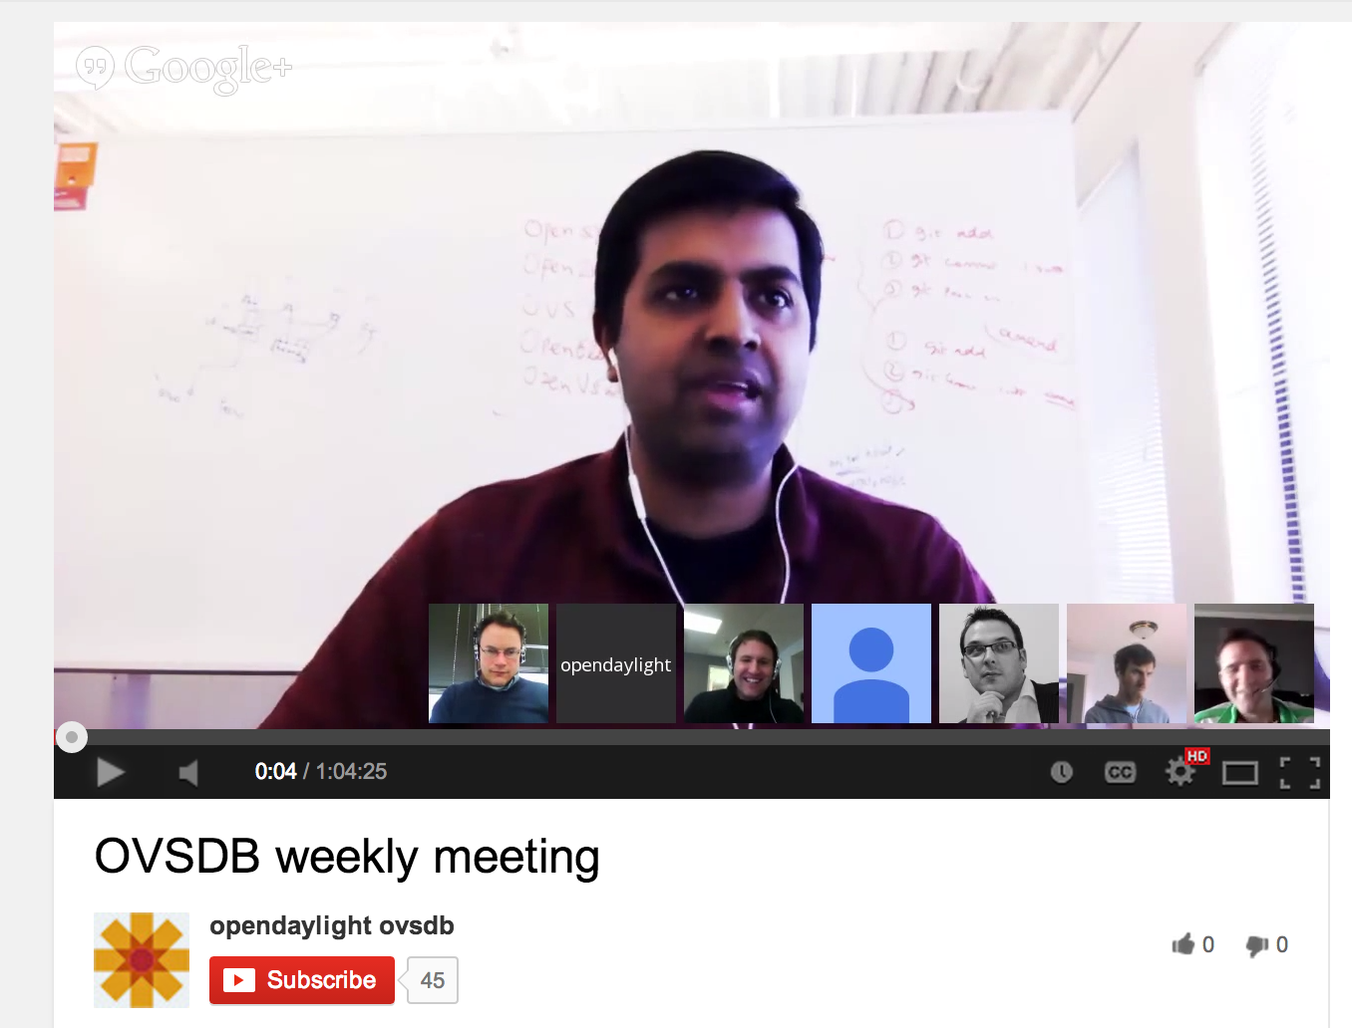
Trend: Open Source (hardware *and* software)
Community building is a core Open Source objective
Code is the coin of the realm
Engineering systems are as important as artifacts
Putting this all together →
Note that open source development is a form of stigmetry/swarm intelligence/autocatalysis/ACO

Slide 8
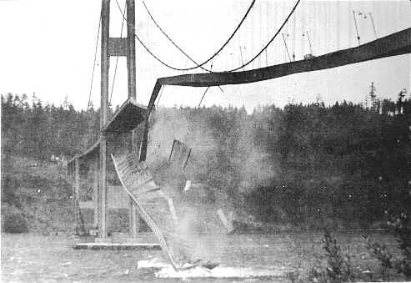
Trend: Engineering artifacts are no longer the source of sustainable advantage and/or innovation
Perhaps surprisingly, the “hyper-scale”
and open source communities have
taught me that actual artifacts (in our
case network applications as well as
HW/SW) are ephemeral entities and
that the only source of sustainable
advantage/innovation consists of
What you build isn’t as
important as how you build it
Engineering Systems¹
Culture
People/Process
Multi-disciplinary Approaches
http://www.sdncentral.com/education/david-meyer-reflections-opendaylight-open-source-project-brocade/2014/03/
Note that our Engineering Systems evolve using the same mechanisms that are used to build artifacts. This is architecturally analogous to autocatalysis/feedback control in biology. This causes acceleration in the design-implement-debug-deploy cycle.

Slide 9
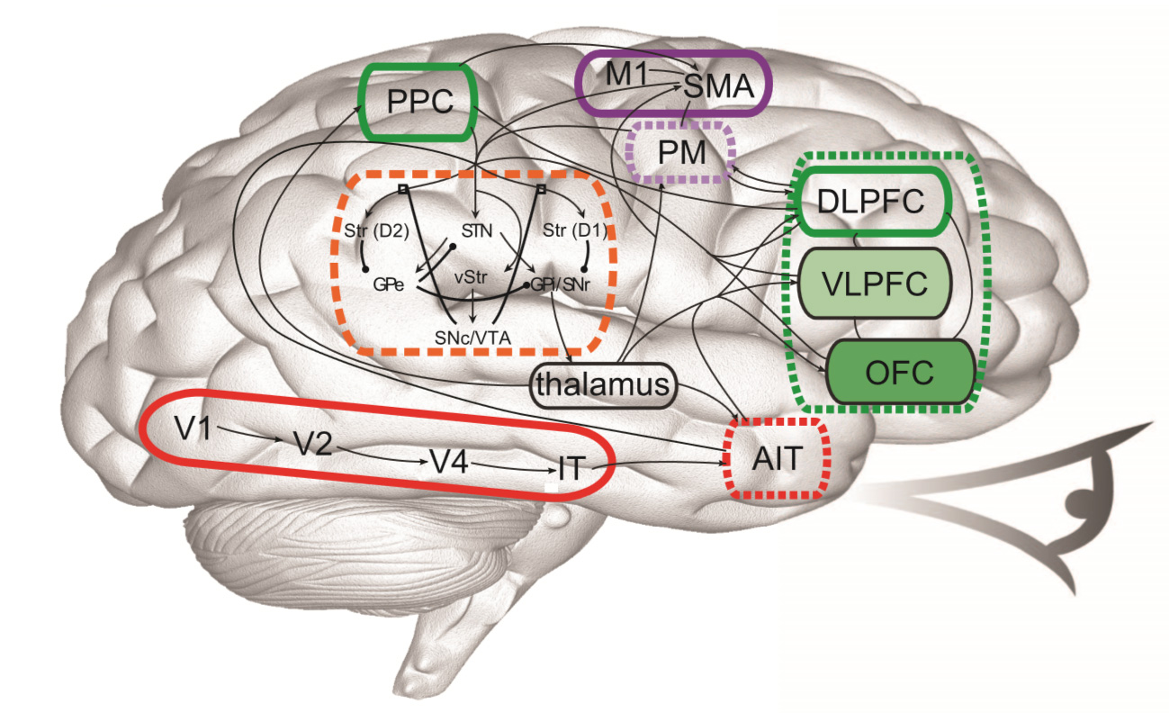
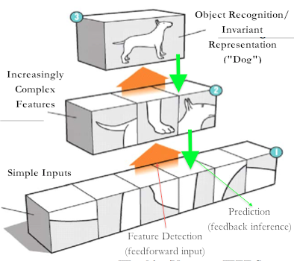
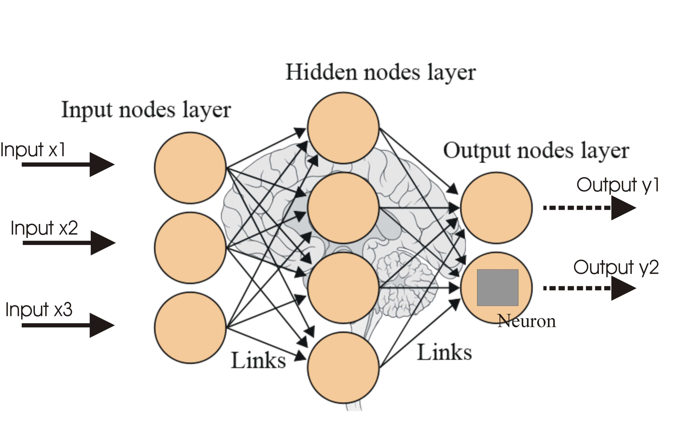
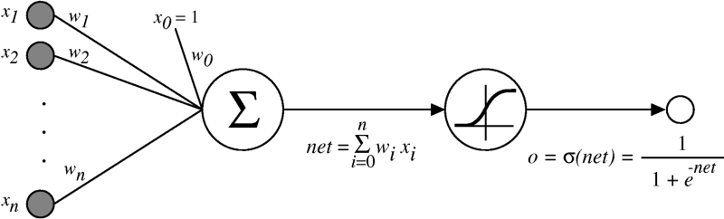
Coming to a Network Near You… Trend: Deep Learning
Things are about to get a lot smarter
https://www.youtube.com/watch?v=HrMU1GgyxL8

Slide 10
Agenda
Too many words, too many slides ☺
This talk is about thinking about networking in new ways
Goals for this Talk
A Few Macro Trends
What is Complexity and Why is it Hidden
Robustness, Fragility, and Complexity
The Architecture of Complex Systems
Universal Architectural Principles
A Few Conclusions and Q&A if we have time

Slide 11
What is Complexity and Why is it Hidden?
Hidden?
Anti-lock/anti-skid brakes, packet loss, OS kernels, power grids, SDN controllers, lunar landing systems, …
You don’t notice they are there until they fail
frequently catastrophically
The hidden nature of complexity is fundamental
So what is Complexity?
Complexity is about creating robustness to environmental and component uncertainty
Ok, then what is Robustness?

Slide 12
Robustness is a Generalized System Feature
Scalability is robustness to changes to the size and complexity of a system as a whole
Evolvability is robustness of lineages to changes on various (usually long) time scales
Other system features cast as robustness
Reliability is robustness to component failures
Efficiency is robustness to resource scarcity
Modularity is robustness to component rearrangements
Of course, these are the features we’re seeking from the network

Slide 13
A Bit More Formally
Robustness is the preservation of a certain property in the presence of uncertainty in components or the environment
Obviously a core Internet design principle
Systems Biology: Biological systems are designed such that their important functions are insensitive to the naturally occurring variations in their parameters.
Limits the number of designs that can actually work in the real environment
Exact adaptation in bacteria chemotaxis
Fragility is the opposite of robustness
Another way to think about fragility
Technical: You are fragile if you depend on 2nd order effects (acceleration) and the “harm” curve is concave
A little more on this in the next few slides…
A system can have a property that is robust to one set of perturbations and yet fragile for a different property and/or perturbation → the system is Robust Yet Fragile
Or the system may collapse if it experiences perturbations above a certain threshold (K-fragile)
For example, a possible RYF tradeoff is that a system with high efficiency (i.e., using minimal system resources) might be unreliable (i.e., fragile to component failure) or hard to evolve
VRRP , ISSU, HA, TE, {5,6,7..}-nines, …
Complexity/Robustness Spirals

Slide 14
So…Robust Yet Fragile
[a system] can have
[a property] that is robust to
[a set of perturbations]
Yet be fragile for
[a different property]
Or [a different perturbation]
Fragile
Robust
Recent results suggest that the RYF tradeoff is a hard tradeoff that cannot be overcome¹
This is profound: If you create robustness you will create fragility somewhere else…
Harm Function: Concave → Fragile, Convex → Robust
¹ See Marie E. Csete and John C. Doyle, “Reverse Engineering of Biological Complexity”,
http://www.cds.caltech.edu/~doyle/wiki/images/0/05/ScienceOnlinePDF.pdf

Slide 15
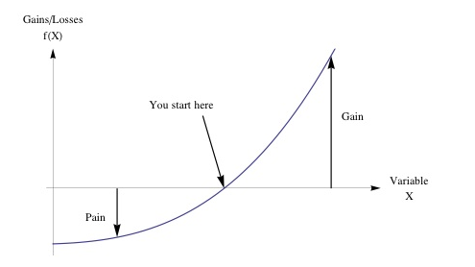
Another way to think about Robustness (Convex Optionality aka No Pain, No Gain)
If you are hurt much less by error/variation than you stand to gain…
Graphic courtesy Nassim Taleb

Slide 16
Interestingly, Fragility and Scaling are Related
A bit of a formal description of fragility
Let z be some stress level, p some property, and
Let H(p,z) be the (negative valued) harm function
Then for the fragile the following must hold
H(p,nz) < nH(p,z) for 0 < nz < K
→ A big event hurts non-linearly more than the sum of small events
For example, a coffee cup on a table suffers non-linearly more from large deviations (H(p, nz)) than from the cumulative effect of smaller events (nH(p,z))
So the cup is damaged far more by tail events than those within a few σ’s of the mean
Sensitivity to tail events → RYF
Too theoretical? Perhaps, but consider: ARP storms, micro-loops, congestion collapse, AS 7007, …
BTW, nature requires this property
Consider: jump off something 1 foot high 30 times v/s jumping off something 30 feet high once
So when we say something scales like O(n²), what we mean is the damage to the network has constant acceleration (2) for weird enough n (e.g., outside say, 10 σ)
Again, ARP storms, congestion collapse, AS 7007, DDOS, … → non-linear damage
Coffee cup example courtesy Nassim Taleb. See http://www.fooledbyrandomness.com

Slide 17
Its All About (RYF) Tradeoffs
Biology and technology
robust
Find a new
job
Robustness
Tradeoff Frontier
fragile
Physics
simple
hard
Complexity

Slide 18
Robust
BTW, RYF Behavior is Everywhere
Yet Fragile
Efficient, flexible metabolism
Complex development and
Immune systems
Regeneration & renewal
Complex societies
Advanced Technologies
Obesity and diabetes
Rich microbe ecosystem
Inflammation, Auto-Im.
Cancer
Epidemics, war, …
Catastrophic failures
“Evolved” mechanisms for robustness allow for, even facilitate, novel, severe fragilities elsewhere. That is, they are RYF-Complex
Often involving hijacking/exploiting the same mechanism
We’ve certainly seen this in the Internet space (consider DDOS of various varieties)
These are hard constraints (i.e., RYF behavior is conserved)

Slide 19
Robust
Fragile
Metabolism
Regeneration & repair
Healing wound /infect
Obesity, diabetes
Cancer
AutoImmune/Inflame
Fat accumulation
Insulin resistance
Proliferation
Inflammation
Same Mechanisms
Fragility ← Hijacking, side effects, unintended…
DDOS, reflection, spoofing, …
Of mechanisms evolved for robustness
Complexity ← control, robust/fragile tradeoffs
Math: robust/fragile constraints (“conservation laws”)
Both
Accident or necessity?

Slide 20
Summary: Understanding RYF is The Challenge
It turns out that managing/understanding RYF behavior is the most essential challenge in technology, society, politics, ecosystems, medicine, etc. This means…
Understanding Universal Architectural Principles
Look ahead: Layering, Bowties/Hourglasses, Constraints that Deconstrain
Managing spiraling complexity/fragility
Not predicting what is likely or typical
But rather understanding what is catastrophic
or in Taleb’s terminology, that which is fat tailed
BTW, it is much easier to create the robust features than it is to prevent the fragilities
And as I mentioned, there are poorly understood “conservation laws” at work¹
Bottom Line
Understanding RYF behavior means understanding architecture and the hidden nature of complexity
¹ See Marie E. Csete and John C. Doyle, “Reverse Engineering of Biological Complexity”,
http://www.cds.caltech.edu/~doyle/wiki/images/0/05/ScienceOnlinePDF.pdf

Slide 21
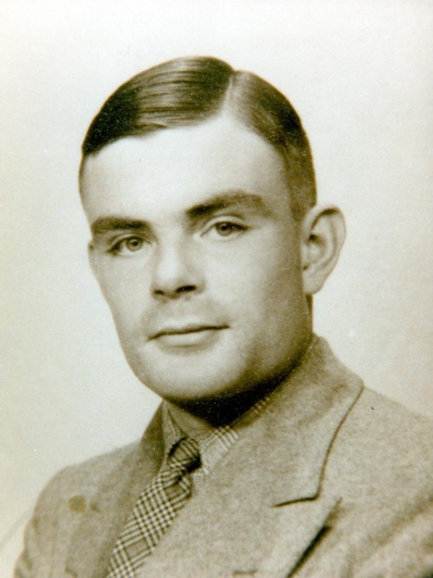
BTW, RYF tradeoffs are fundamental
Example: Computational Complexity
Layering, Formal Systems, Hard Tradeoffs
Architecture (constraints that deconstrain)
Slow
Architecture
Impossible (law)
Fast
ideal
Flexible
Inflexible
General
Special
Original slide courtesy John Doyle

Slide 22
Drilling down a bit on the Computational Complexity Tradeoff Space
Really slow
UTMs
Slow
hard limits
Fast
Undecidable
⊃ Decidable
⊃ NP
⊃ P?
Flexible/
General
Inflexible/
Specific
Notes:
.

Slide 23
Another Example: Feedback Control Theory
(Gain/Sensitivity Tradeoff In Feedback Control)
Bode Sensitivity Integral
Low
Tradeoff ≈ Law
Gain
Feasible Frontier
tradeoff
Impossible
ideal
High
Precise
Sloppy
Precision

Slide 24
Other Universal Tradeoffs?
Slow
Learning
Evolution
Fast
Flexible
Inflexible

Slide 25
Fragile
Slow
In reality the tradeoff
space is of higher dimension
Fast
Robust
Cheap
Flexible
Inflexible
Expensive
Efficient vs Robust

Slide 26
Agenda
Too many words, too many slides ☺
This talk is about thinking about networking in new ways
Goals for this Talk
A Few Macro Trends
What is Complexity and Why is it Hidden
Robustness, Fragility, and Complexity
The Architecture of Complex Systems
Universal Architectural Principles
A Few Conclusions and Q&A if we have time

Slide 27
The Architecture of Complex Systems
What we have learned is that there are universal architectural building blocks found in systems that scale and are evolvable. These include
Architecture/Layering
Laws, constraints, tradeoffs
Protocol Based Architectures
Massively distributed with robust control loops
Consequences
Hidden RYF Complexity
Hijacking, parasitism, predation

Slide 28
So What is the Basic Layered Architecture?
(hint: layering is the fundamental architectural feature)
Deconstrained
(Applications)
Diverse
Apps
Core Protocols
Constrained
and hidden
OS
Diverse
Deconstrained
(Hardware)
HW
Slide courtesy John Doyle

Slide 29
Bowties, Hourglasses and Layering
fan-in
of diverse
inputs
fan-out
of diverse
outputs
Bowtie
Universal Carriers
Diverse
function
Universal Architectural Principles
Layering As Optimization Decomposition View¹
Universal
Control
Hourglass
Hourglasses for layering of control
Bowties for flows within layers
Constraints that Deconstrain
Diverse
components
1 http://www.princeton.edu/~chiangm/layering.pdf

Slide 30
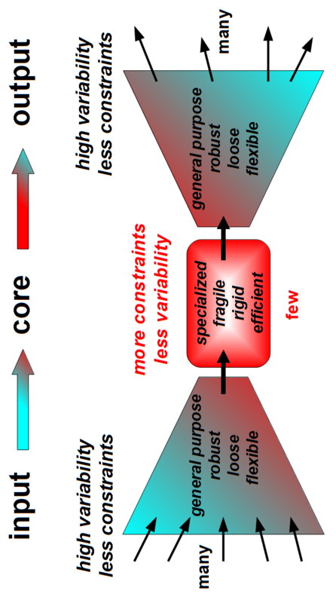
Bowties 101 Constraints that Deconstrain Schematic of a “Layer”
For example, the reactions and metabolites of core
metabolism, e.g., Adenosine Triphosphate (ATP) metabolism,
Krebs/Citric Acid Cycle, … form a “metabolic knot”. That is, ATP
is a Universal Carrier for cellular energy.
Processes L-1 information and/or raw material flows into a “standardized” format (the L+1 abstraction)
Provides plug-and-play modularity for the layer above
Provides robustness but at the same time fragile to attacks against/using the standardized interface
See Kirschner M., and Gerhart J., “Evolvability”, Proc Natl Acad Sci USA , 95:8420–8427, 1998.

Slide 31
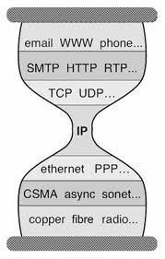
But Wait a Second Anything Look Familiar?
Bowtie Architecture
Hourglass Architecture
Comes down to whether you see layering as horizontal or vertical
The Protocol Hourglass idea appears to have originated with Steve Deering. See Deering, S., “Watching the Waist of the Protocol Hourglass”, IETF 51,
2001, http://www.iab.org/wp-content/IAB-uploads/2011/03/hourglass-london-ietf.pdf.
Notes:
Bowties for flows w/in layers, and Hourglasses for layering of control

Slide 32
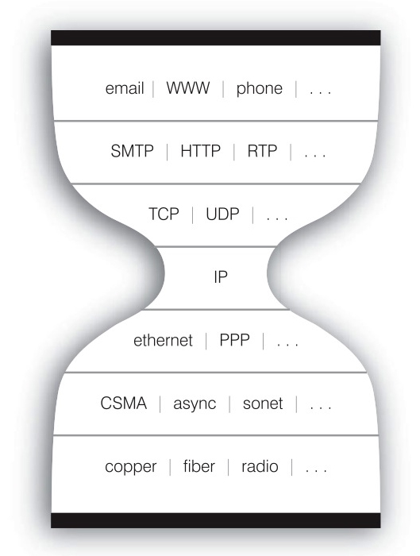
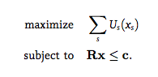
The Nested Bowtie/Hourglass Architecture of the Internet
Layering of Control
HTTP Bowtie
Input: Ports, Datagrams, Connections
Output (abstraction): REST
TCP/UDP Bowtie
Input: IP Packets
Output (abstraction): Ports, Datagrams, Connections
REST
BTW, we like to talk about the “thinness” of the waist
What is critical is its constrained/hidden nature
Connections
Datagrams
Ports
HTTP(S)
REST
Layering of Control/Abstractions
TCP/UDP
Connections
Datagrams
Ports
IP Packets
Flows within Layers
Reverse/forward engineering Network Utility Maximum (NUM) problem

Slide 33
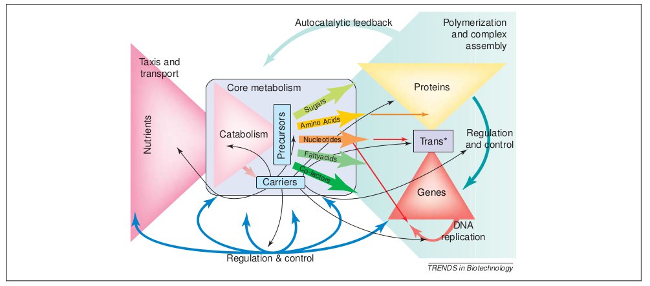
In Practice Things are More Complicated The Nested Bowtie/Hourglass Architecture of Metabolism
See Csete, M. and J. Doyle, “Bowties, metabolism and disease”, TRENDS in Biotechnology, Vol. 22 No. 9, Sept 2004

Slide 34
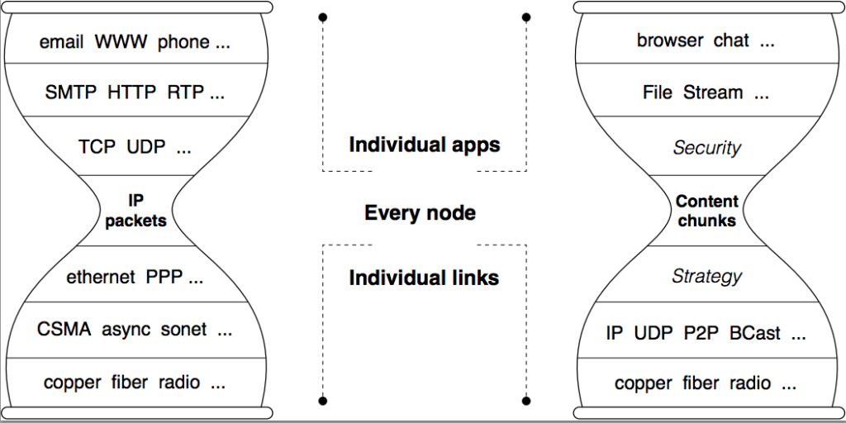
Named Data Networking Hourglass
See Named Data Networking, http://named-data.net/

Slide 35
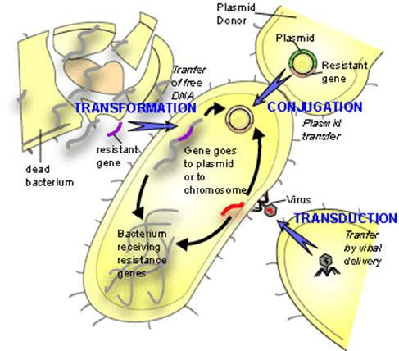
Key Architectural Concept: Horizontal Transfer
HGT
Deconstrained
(Applications)
Diverse
Apps
Horizontal App Transfer
Layered Architectures make Robustness and
Evolvability Compatible
OS
OS
H*T
HW
Diverse
Deconstrained
(Hardware)
Horizontal HW Transfer

Slide 36
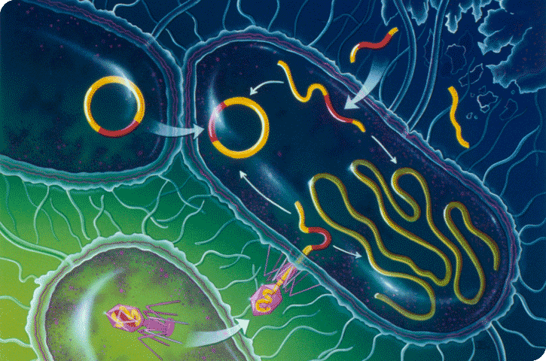
Drilling Down: HGT and antibiotic resistance
Sequence ~100 E Coli (not chosen randomly)
~ 4K genes per cell
~20K different genes in total (pangenome)
~ 1K universally shared genes
~ 300 essential (minimal) genes
DNA
New gene
Gene
RNA
RNAp
Transcription
Other
Control
mRNA
Amino
Acids
Ribosomes
Translation
Horizontal Gene Transfer
Other
Control
Proteins
Metabolism
Products
ATP
control feedback
Signal transduction
Notes:
.

Slide 37
Putting it all Together
Architecture, Layering, and Tradeoffs
Unconstrained/Diverse
Slow
Apps
OS
Constrained/Hidden
HW
Fast
Unconstrained/Diverse
Flexible
Inflexible
General
Special

Slide 38
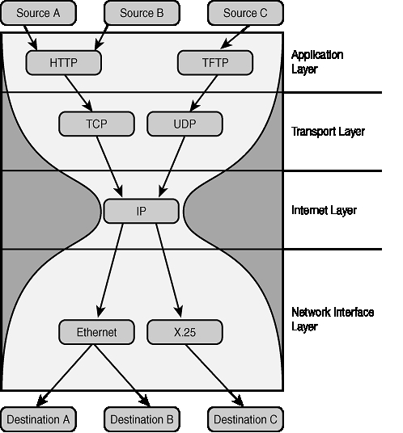
Example: Layered Network Architectures
(Internet)
Unconstrained/Diverse
Slow
Apps
OS
Constrained/Hidden
Standardized Contracts
HW
Fast
Unconstrained/Diverse
Flexible
Inflexible
General
Special

Slide 39
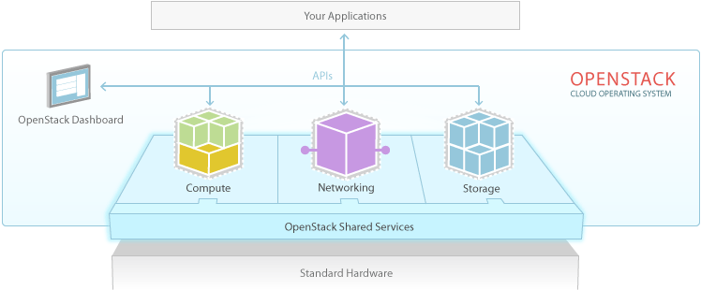
Example: OpenStack
Unconstrained/Diverse
Slow
Apps
OS
Constrained/Hidden
Standardized Contracts
HW
Fast
Unconstrained/Diverse
Flexible
Inflexible
General
Special

Slide 40
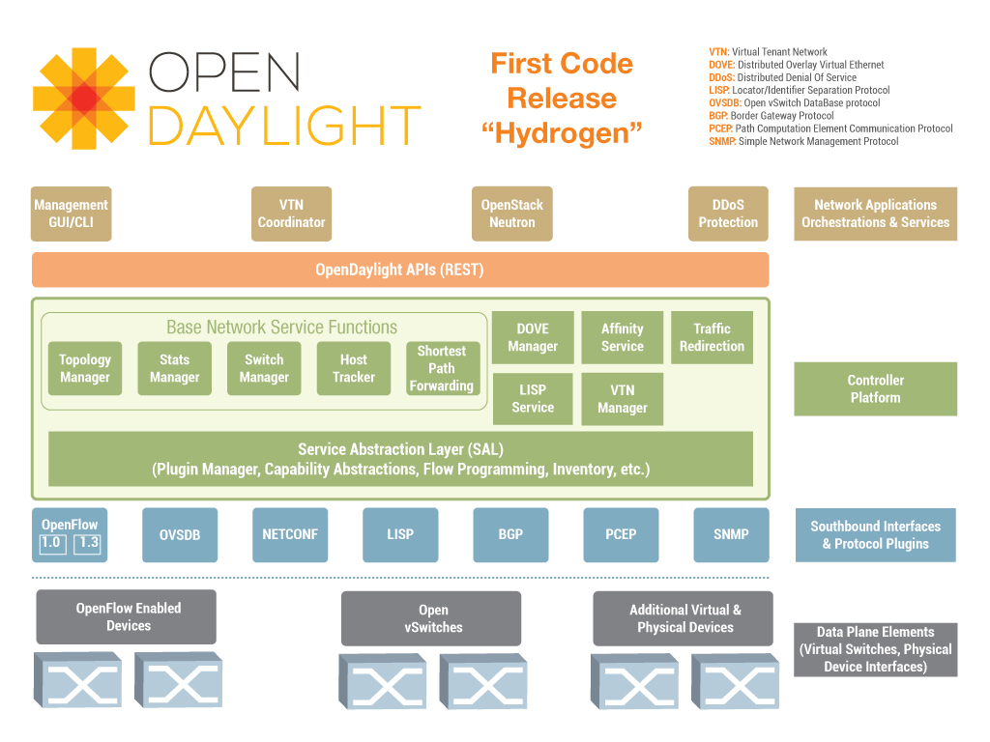
Example: SDN
Unconstrained/Diverse
Slow
Apps
OS
Constrained/Hidden
Standardized Contracts
HW
Fast
Unconstrained/Diverse
Flexible
Inflexible
General
Special

Slide 41
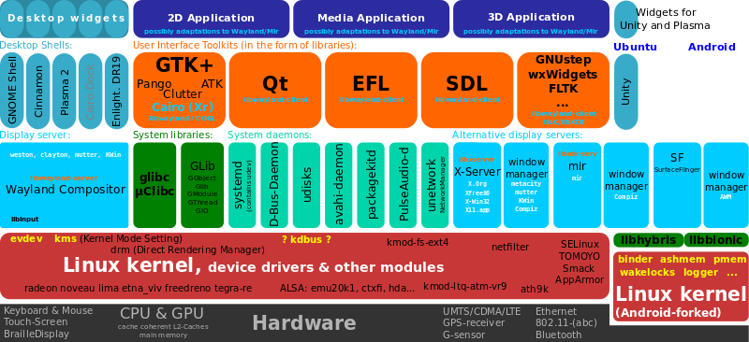
Linux Kernel?
OS

Slide 42
So I’ve been talking a bit about Biology
Are biological systems architecturally layered in the same way?
Basically diverse apps and h/w, hidden kernel
Constraints that deconstrain
If so, what kinds of systems can we analyze this way?

Slide 43
What could possibly go wrong?
Layered Architectures and Tradeoff Spaces
In Biology
DNA
New gene
Gene
RNA
RNAp
Transcription
Other
Control
mRNA
Amino
Acids
Slow
Cheap
Ribosomes
Translation
HGT
DNA repair
Mutation
DNA replication
Transcription
Translation
Metabolism
Signal…
Other
Control
Proteins
Metabolism
Products
ATP
control feedback
Signal transduction
Fast
Costly
Flexible
Inflexible
General
Special

Slide 44


Neuroscience Example: The Vestibular Ocular Reflex (VOR)
Reflex eye movement that stabilizes images on the retina during head movement
Mechanism
Vestibular Ocular Reflex
Slow
vision
Tradeoff
VOR
Fast
Flexible
Inflexible

Slide 45
eye
vision
slow
Act
delay
Slow
vision
Fast
Flexible
Inflexible

Slide 46
eye
vision
fast
slow
Act
delay
Slow
vision
VOR
Fast
Flexible
Inflexible

Slide 47
Slowest
3D +
motion
color
vision
eye
vision
fast
slow
Act
delay
Slow
vision
VOR
Fast
Flexible
Inflexible

Slide 48
vision
Prefrontal
Slow
Learn
Motor
Fast
Sense
Apps
OS
HW
Dig.
Lump.
Distrib.
OS
HW
Dig.
Lump.
Distrib.
Digital
Lump.
Distrib.
Lumped
Distrib.
Distrib.
Evolve
VOR
Reflex
Ideal?
Fast
Flexible
Inflexible
General
Special
So can a new architecture beat the tradeoff?
Notes:
Notes: Please provide additional information here.

Slide 49

vision
Prefrontal
Slow
Learn
Motor
Fast
Sense
Apps
OS
HW
Dig.
Lump.
Distrib.
OS
HW
Dig.
Lump.
Distrib.
Digital
Lump.
Distrib.
Lumped
Distrib.
Distrib.
Evolve
VOR
Reflex
Fast
Flexible
Inflexible
General
Special
Be careful what you wish for…
http://packetpushers.net/artificial-intelligence-brains-networks-bugs-complexity/
Notes:
Notes: Please provide additional information here.

Slide 50
thin
small
Not viable?
fragile
Evolution
Good architecture?
Survive
thick
big
Laws?
robust
Impossible?
Multiply
Fast
Efficient
Cheap
Slow
Costly

Slide 51
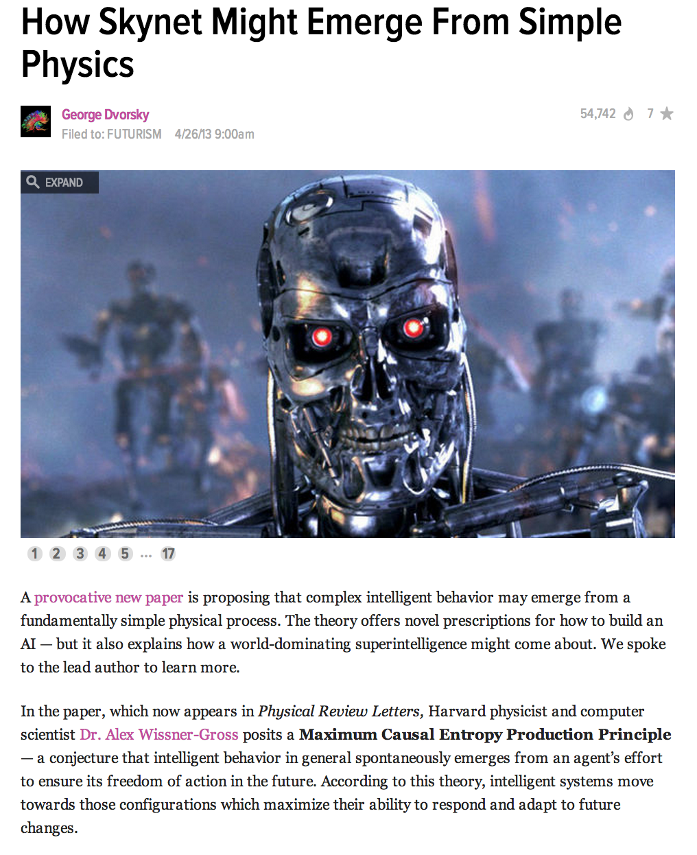
Speaking of Being Careful…
Dr. Alex Wissner-Gross -- Maximum Causal Entropy Production Principle
This is a conjecture that intelligent behavior in general spontaneously emerges from
an agent’s effort to ensure its freedom of action in the future
→ Intelligent systems move towards the configurations which maximize
their ability to respond and adapt to future changes
http://io9.com/how-skynet-might-emerge-from-simple-physics-482402911

Slide 52
Hopefully I’ve Convinced You…
That there are Universal Architectural Features that are common to biology and technology
Laws, constraints, tradeoffs
Robust/fragile
Efficient/wasteful
Fast/slow
Flexible/inflexible
Architecture/Layering
Hidden RYF Complexity
Hijacking, parasitism, predation
Ok, but why is this useful?

Slide 53
Why is all of this Useful?
Robust systems are intrinsically hard to understand
RYF is an inherent property of both advanced technology and biology
Understanding general principles informs what we build
Software (e.g., SDN, NFV, Cloud, …) exacerbates the situation
And the Internet has reached an unprecedented level of complexity →
Need new/analytic ways of designing, deploying, and operating networks
Nonetheless, many of our goals for the Internet architecture revolve around how to achieve robustness…
which requires a deep understanding of the necessary interplay between complexity and robustness, modularity, feedback, and fragility¹
which is neither accidental nor superficial
Rather, architecture arises from “designs” to cope with uncertainty in environment and components
The same “designs” make some protocols hard to evolve
Can anyone say, um, IPv6 (or even DNSSEC)?
¹ See Marie E. Csete and John C. Doyle, “Reverse Engineering of Biological Complexity”,
http://www.cds.caltech.edu/~doyle/wiki/images/0/05/ScienceOnlinePDF.pdf

Slide 54
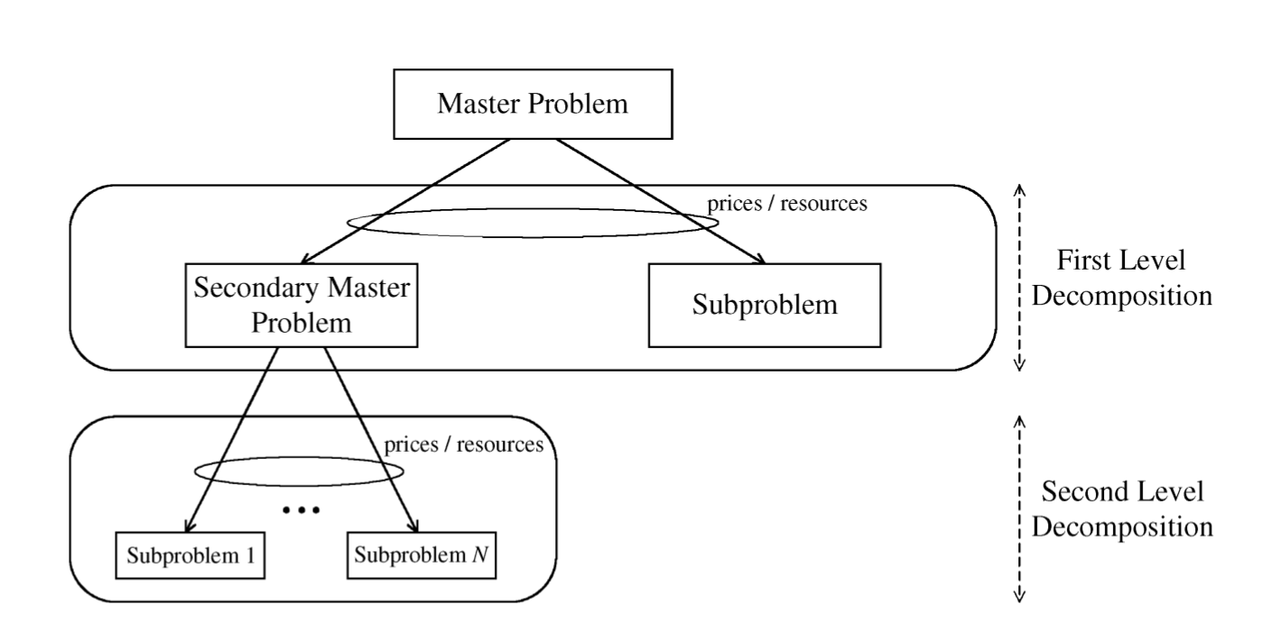
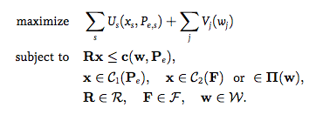
Why is all of this Useful, cont?
This much seems obvious
Understanding these universal architectural features and tradeoffs will help us achieve the scalability and evolvability (operability, deployability, understandability) that we are seeking from the Internet architecture today and going forward
Perhaps less obvious: This requires a mathematical theory of network architecture
Want to be able to analyze/compare/simulate/optimize all aspects of network design/operation
Mathematics the natural language for this
BTW, as engineers we solve problems (“engineers always know first”), but we can benefit from the tools that theory can provide to help us design/deploy/operate/optimize our networks
First Cut: “Layering as Optimization Decomposition: A Mathematical Theory of Network Architectures”¹
Network Utility Maximization (NUM)/Layering As Optimization (LAO)/Decomposition Theory
TCP and Stable Path Problem (BGP) reverse-engineered as Generalized NUM problems
Need something like LAO/G-NUM + “Constraints that deconstrain” view
Bridge Building
http://conferences.sigcomm.org/sigcomm/2014/tutorial-theory+eng.php
1 http://www.princeton.edu/~chiangm/layering.pdf

Slide 55
Q&A
Thanks!

